Slide 1

Introduction to python
week1

Slide 2
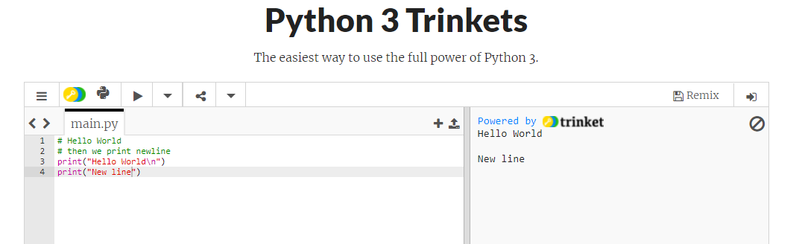
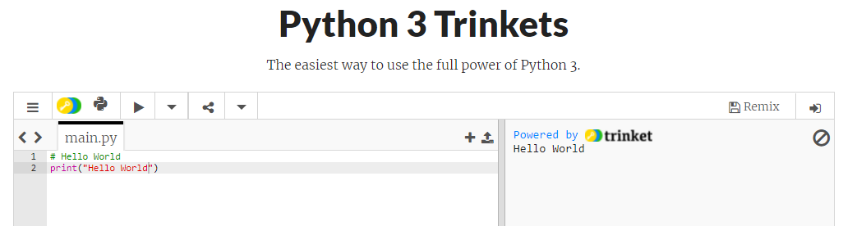
Let’s create a Hello World

Slide 3
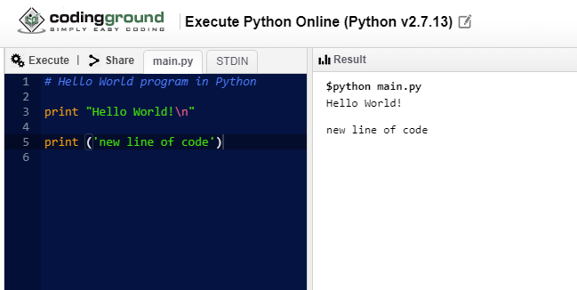
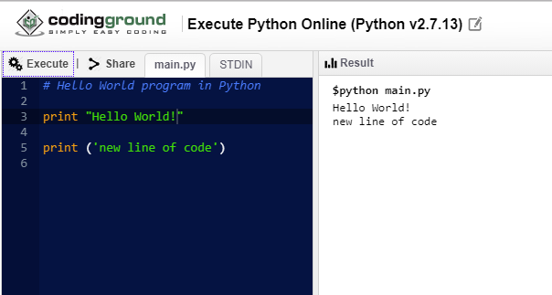

Slide 4
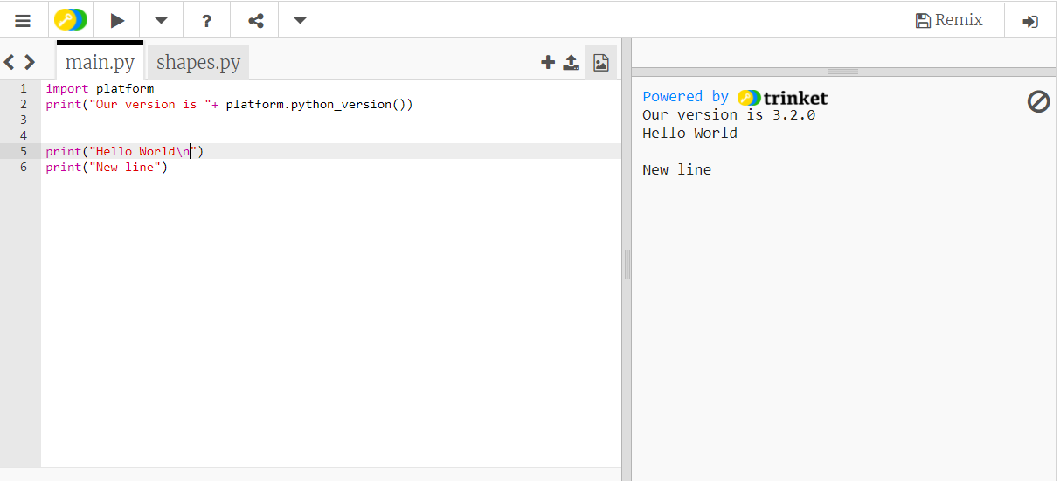
Version of our platform
Notes:
Platform is the module. A module is a file containing Python definitions and statements. A module can define functions, classes, and variables. A module can also include runnable code. Grouping related code into a module makes the code easier to understand and use. It also makes the code logically organized.
Explain about \n.
https://www.geeksforgeeks.org/platform-module-in-python/

Slide 5
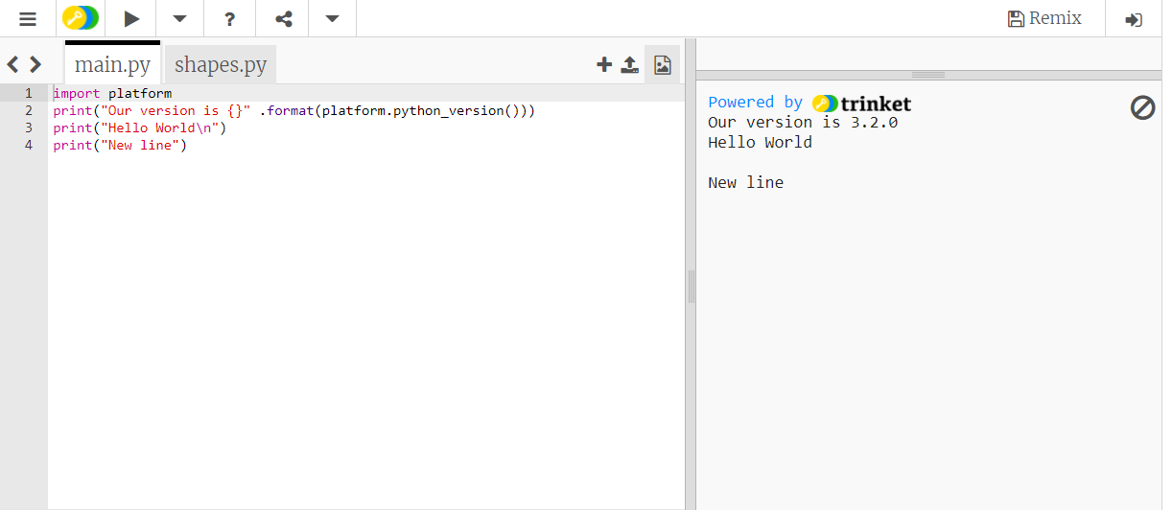
Notes:
The format() method formats the specified value(s) and insert them inside the string's placeholder.
The placeholder is defined using curly brackets: {}.

Slide 6
Built-in Data Types
In programming, data type is an important concept.
Variables can store data of different types, and different types can do different things.
Python has the following data types built-in by default, in these categories:
Text Type : str
Numeric Types: int, float, complex
Sequence Types: list, tuple, range
Mapping Type: dict
Set Types: set, frozenset
Boolean Type: bool
Binary Types: bytes, bytearray, memoryview

Slide 7
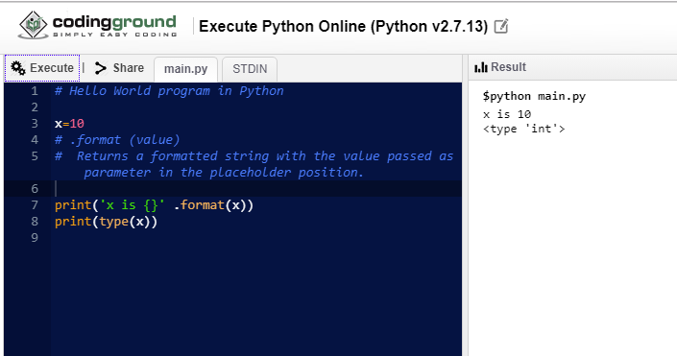
What is next? Types and values

Slide 8
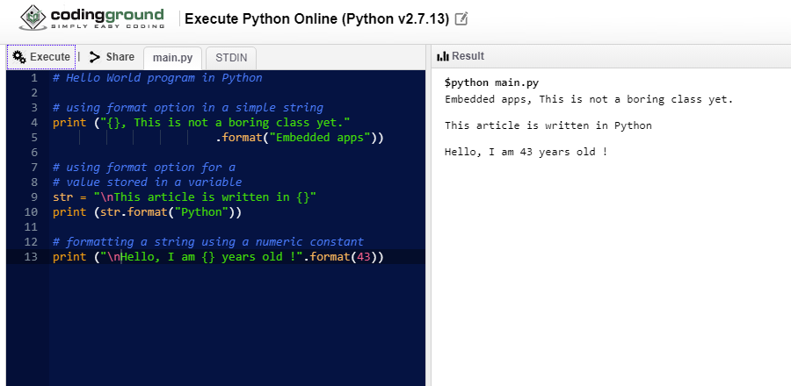
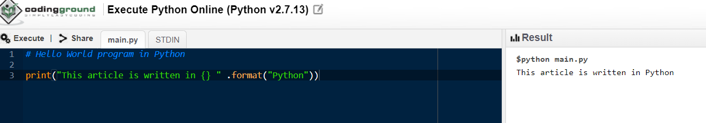
Example 1: Single formatter

Slide 9
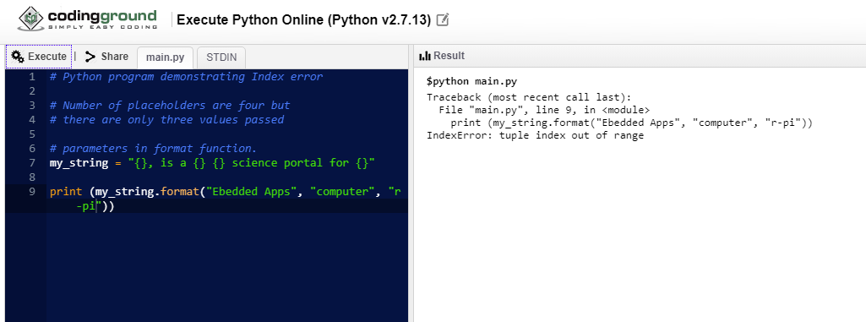
Example 2: Using Multiple Formatters : (Python will replace the placeholders by values in order.)

Slide 10
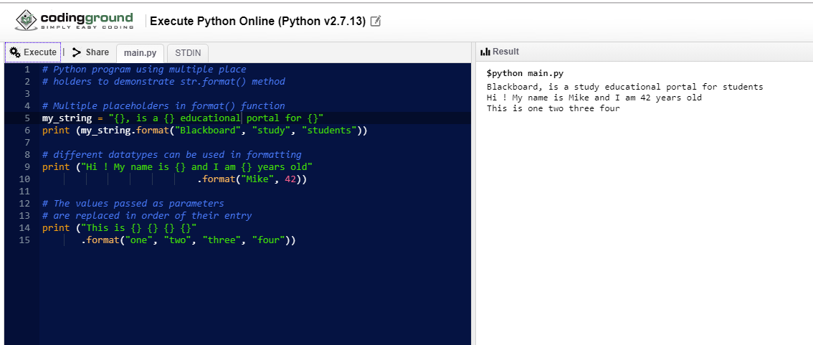
Example 3: Formatters with multiple place holders.

Slide 11
Formatters with Positional and Keyword Arguments : (When placeholders { } are empty, Python will replace the values passed through str.format() in order.)

Slide 12
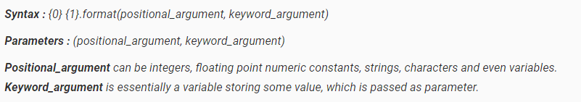
Exaplanation:

Slide 13
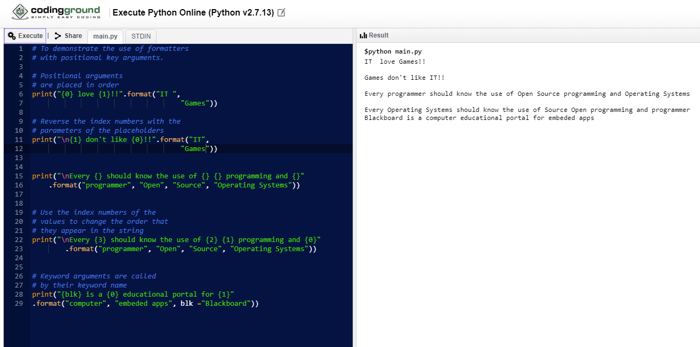
Example 4

Slide 14
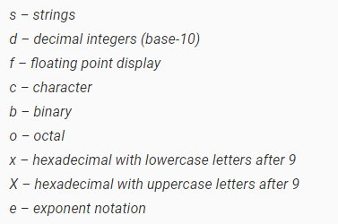
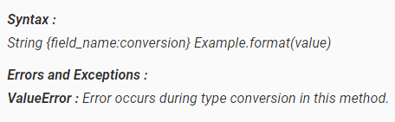
Type specifying:
More parameters can be included within the curly braces of our syntax.
Use the format code syntax {field_name:conversion}, where field_name specifies the index number of the argument to the str.format() method, and conversion refers to the conversion code of the data type.

Slide 15
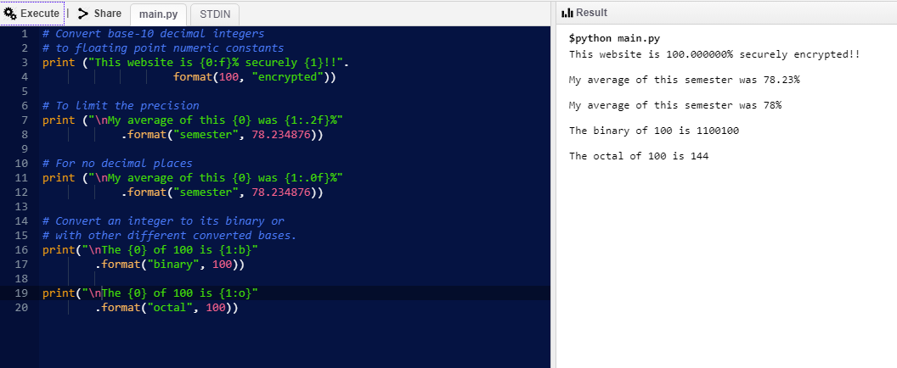
Example 5

